Slide 1
Probability distributions and Introduction to Statistical Inference
bio5312 Fall2017
stephanie j. spielman, PhD

Slide 2
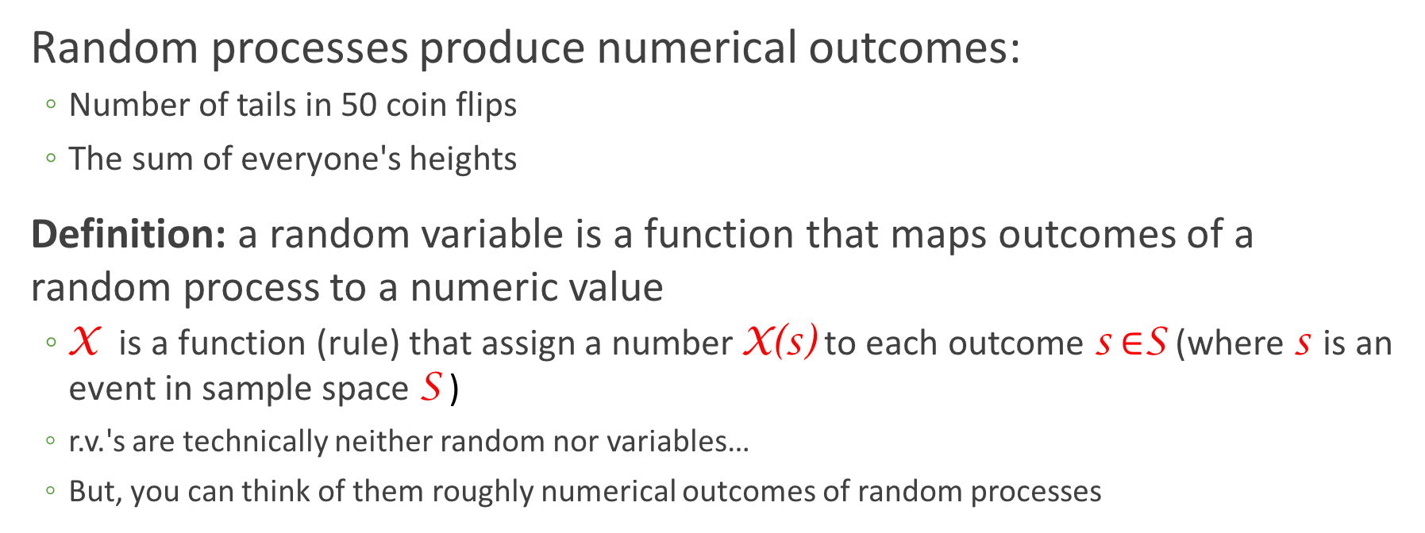
Random variable
Random processes produce numerical outcomes:
Number of tails in 50 coin flips
The sum of everyone's heights
Definition: a random variable is a function that maps outcomes of a random process to a numeric value
X is a function (rule) that assign a number X(s) to each outcome s $∈$S (where s is an event in sample space S )
r.v.'s are technically neither random nor variables…
But, you can think of them roughly numerical outcomes of random processes

Slide 3
Discrete vs continuous RV
Discrete random variables can take on (map to) a finite number of values
Continuous random variables can take on (map to) innumerable/infinite values

Slide 4
Expressing discrete random variables
Probability mass function (PMF)
Describes the values taken by a discrete r.v. X and its associated probabilities
Function that assigns, to any possible value x of a discrete r.v. X, the probability P(X = x)
PMF for rolling a fair die
P(X = x)
x

Slide 5
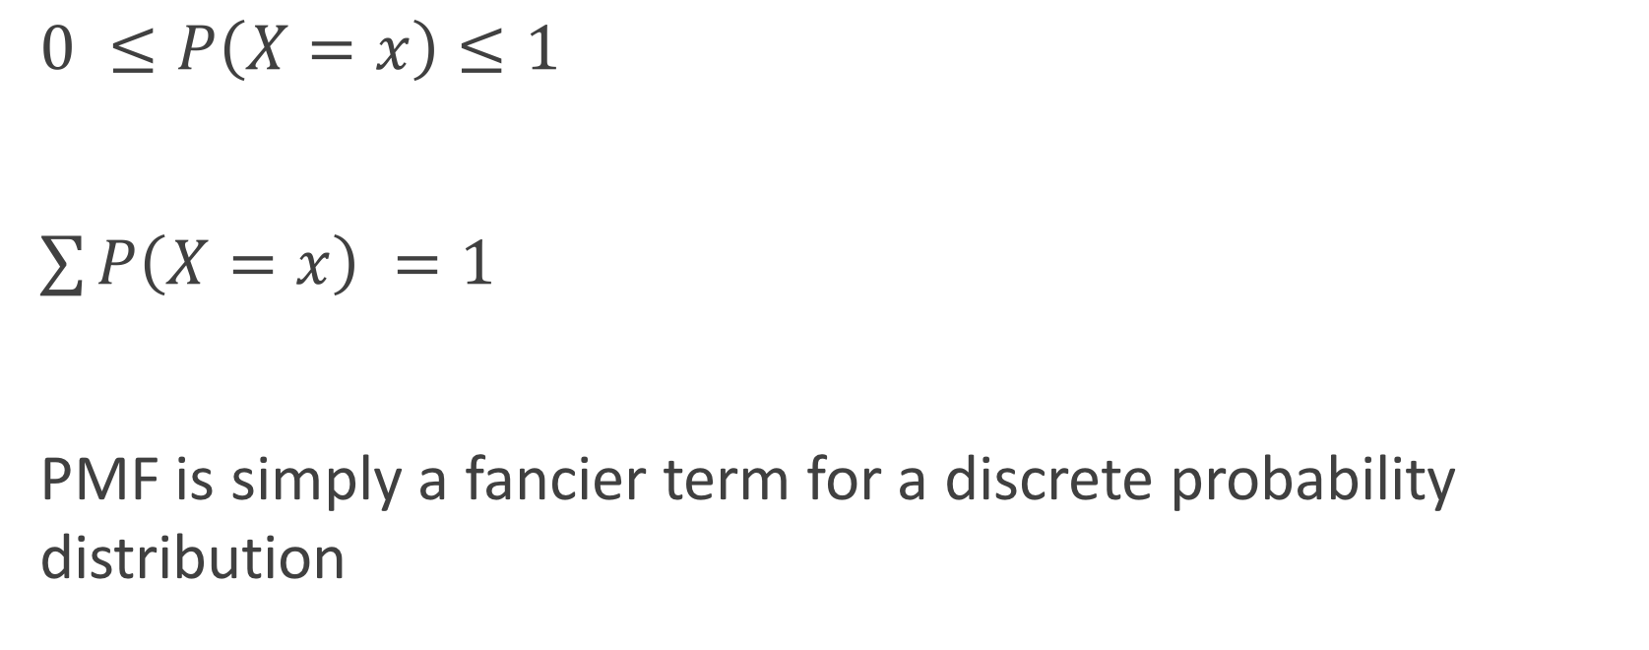
PMF properties
$0 ≤P\left(X=x\right)≤1$
$\sum{P\left(X=x\right) =1}$
PMF is simply a fancier term for a discrete probability distribution

Slide 6
Expressing discrete random variables
Cumulative distribution function (CDF)
Function defined, for a specific value x of a discrete r.v. X, as F(x) = P(X ≤ x)
CDF for rolling a fair die
P(X ≤ 4)
P(X ≤ 1)

Slide 7
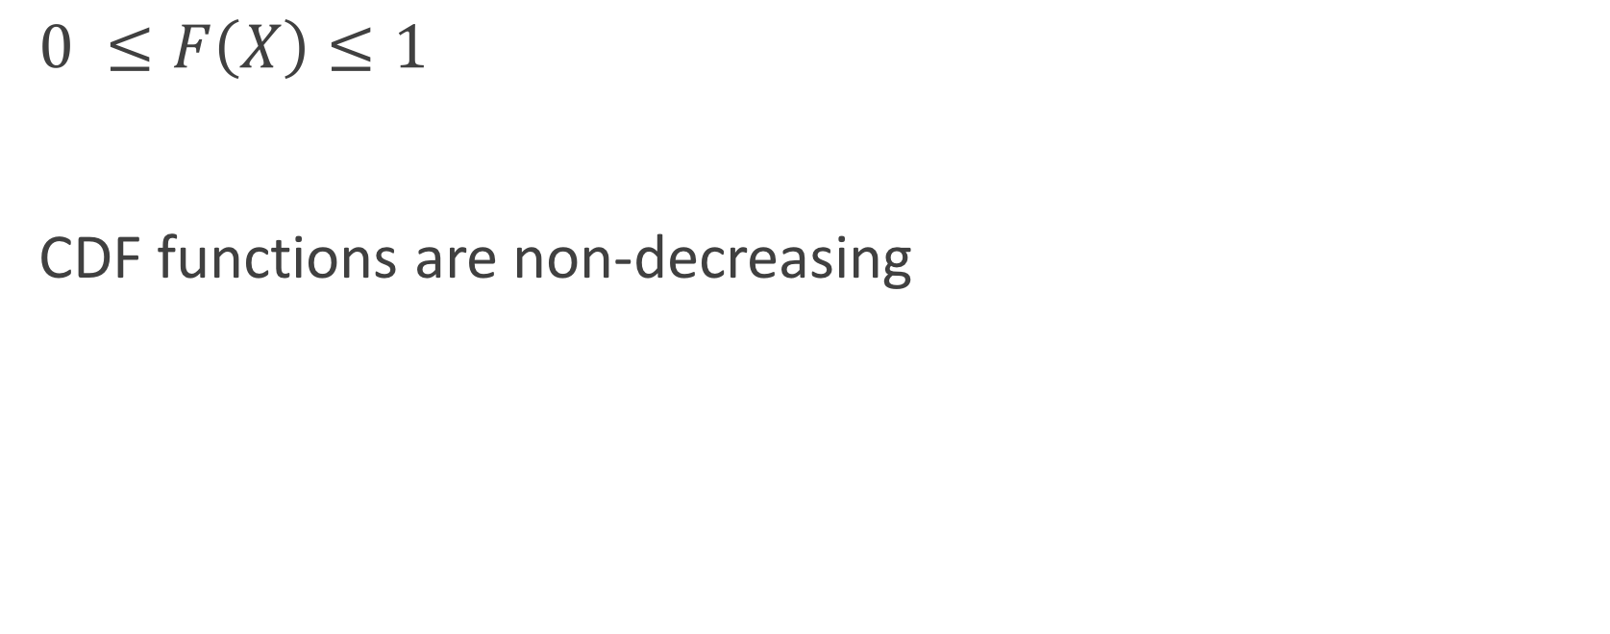
CDF properties
$0 ≤F\left(X\right)≤1$
CDF functions are non-decreasing

Slide 8
PMF vs CDF
PMF: What is the probability of event X?
CDF: What is the sum of probabilities for all events ≤ X?

Slide 9
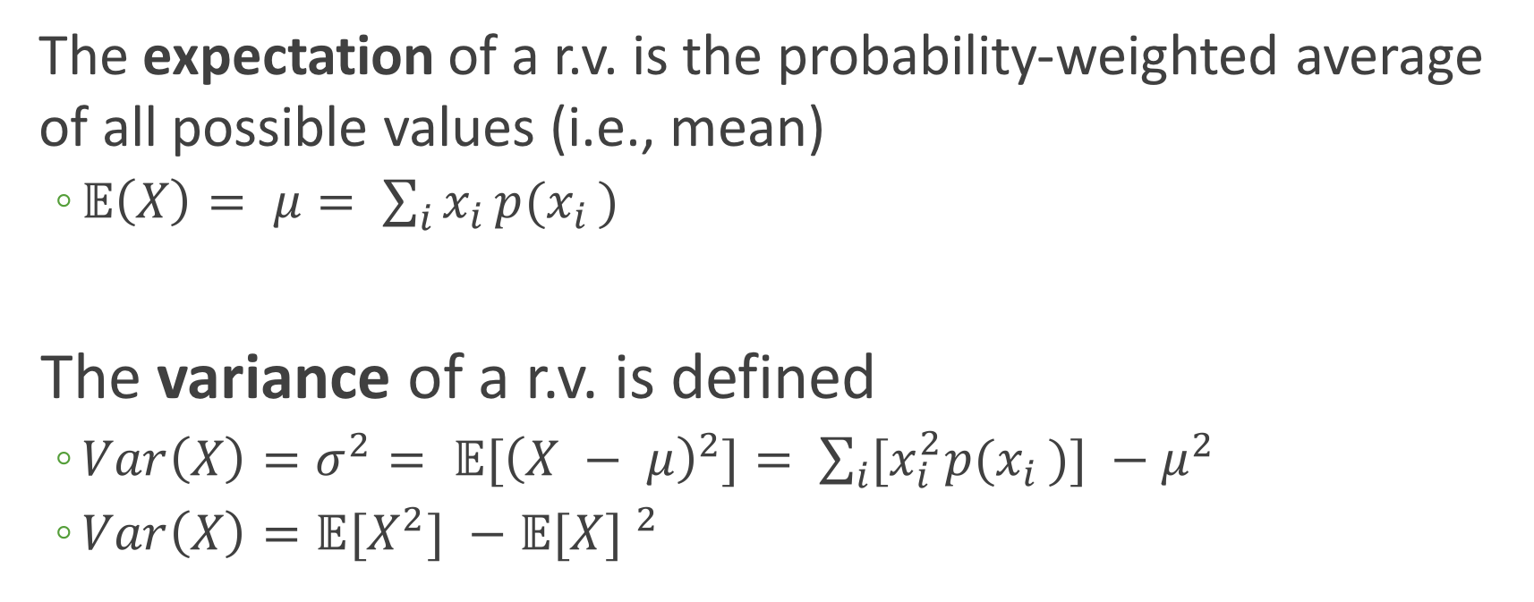
Expectation and spread of random variables
The expectation of a r.v. is the probability-weighted average of all possible values (i.e., mean)
$𝔼\left(X\right)= μ= \sum_{i}{x_{i }{p(x}_{i })}$
The variance of a r.v. is defined
$Var\left(X\right)=σ^{2}= 𝔼{[\left(X − μ\right)}^{2}]= \sum_{i}{[x_{i}^{2}{p(x}_{i })}] −μ^{2}$
$Var\left(X\right)=𝔼{[X}^{2}] −{𝔼[X] }^{2}$

Slide 10
Example: The Binomial distribution
The binomial distribution describes the probability of obtaining k successes in n Bernoulli trials, where the probability of success for each trial is constant at p
A Bernoulli trial has a binary outcome (success/fail, true/false, yes/no), and P(success) = p is the same for all realizations of the trial

Slide 11
The BInS conditions
To be binomially distributed, must satisfy the following:
Binary outcomes
Independent trials (outcomes do not influence each other)
n is fixed before the trials begin
Same probability of success, p, for all trials

Slide 12
Is it binomial?
A bag contains 10 balls, 7 red and 3 green.
Situation 1: You draw 5 balls from the bag, noting the ball color each time and then returning it to the bag. Yes!
Situation 2: You draw 5 balls from the bag, retaining each drawn ball for safe-keeping so you can play catch at any moment. No ☹
Situation 3: You keep drawing balls, with replacement, until you have drawn 4 red balls. No ☹

Slide 13
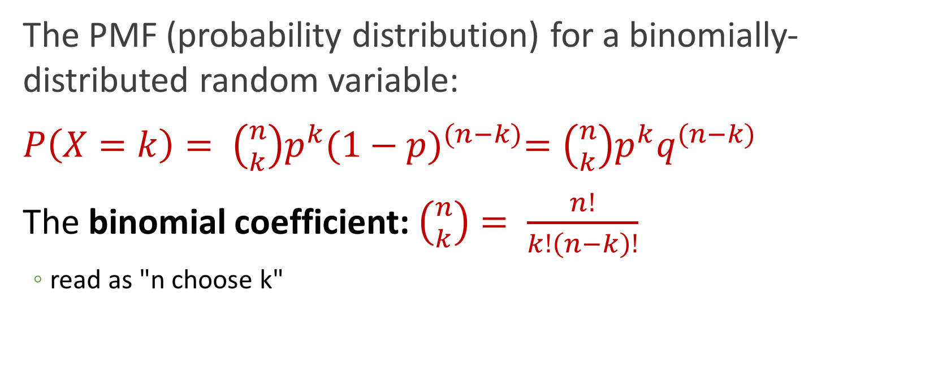
The binomial distribution
The PMF (probability distribution) for a binomially-distributed random variable:
$P\left(X=k\right)= \left({n \atop k}\right)p^{k}{(1−p)}^{(n−k)}=\left({n \atop k}\right)p^{k}q^{(n−k)}$
The binomial coefficient: $\left({n \atop k}\right)= \frac{n!}{k!\left(n−k\right)!}$
read as "n choose k"

Slide 14
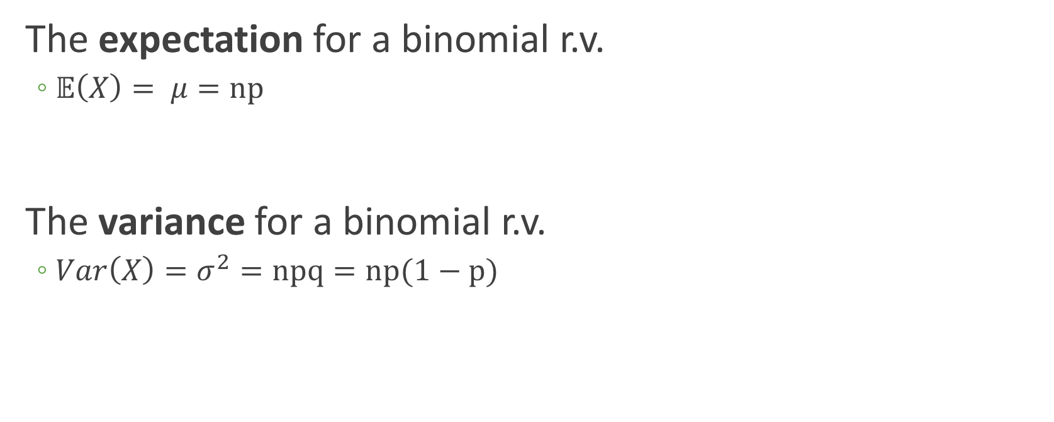
The binomial distribution
The expectation for a binomial r.v.
$𝔼\left(X\right)= μ=np$
The variance for a binomial r.v.
$Var\left(X\right)=σ^{2}=npq=np(1−p)$

Slide 15
Example: Playing with a binomial rv
Each child born to a particular set of parents has a 25% probability of having blood type O. Assume the parents had five children.
Here, n = 5 and p = 0.25, meaning we define Type O as "success", and not Type O as "failure".
Tasks:
Compute expectation and variance
Visualize PMF
Visualize CDF
Make some calculations…

Slide 16
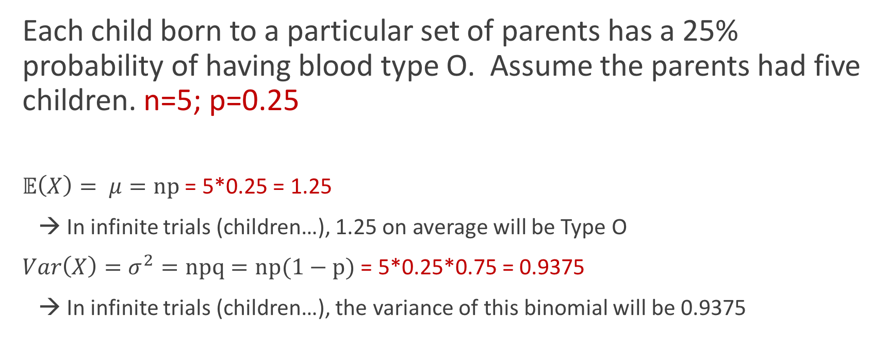
Expectation and variance
Each child born to a particular set of parents has a 25% probability of having blood type O. Assume the parents had five children. n=5; p=0.25
$𝔼\left(X\right)= μ=np$ = 5*0.25 = 1.25
→ In infinite trials (children…), 1.25 on average will be Type O
$Var\left(X\right)=σ^{2}=npq=np(1−p)$ = 5*0.25*0.75 = 0.9375
→ In infinite trials (children…), the variance of this binomial will be 0.9375

Slide 17
Visualize the PMF

Slide 18
?distributions
Distributions in the stats package
Description:
Density, cumulative distribution function, quantile function and
random variate generation for many standard probability
distributions are available in the ‘stats’ package.
Details:
The functions for the density/mass function, cumulative
distribution function, quantile function and random variate
generation are named in the form ‘dxxx’, ‘pxxx’, ‘qxxx’ and ‘rxxx’
respectively.
For the beta distribution see ‘dbeta’.
For the binomial (including Bernoulli) distribution see ‘dbinom’.
For the Cauchy distribution see ‘dcauchy’.
For the chi-squared distribution see ‘dchisq’.

Slide 19
Distribution functions, generally
Function | Purpose | Binomial version
dxxx() | Probability distribution | dbinom(x, size, prob)
pxxx() | CDF | pbinom(q, size, prob)
rxxx() | Generate random numbers from given distribution | rbinom(n, size, prob)
qxxx() | Inverse of pbinom() | qbinom(p, size, prob)

Slide 20
Binomial distribution functions
Binomial function | Example | Output
dbinom(x, size, prob) | dbinom(2, 5, 0.25) | Prob of obtaining 2 successes in 5 trials, where p=0.25 → 0.263
pbinom(q, size, prob) | pbinom(2, 5, 0.25) | Prob of obtaining ≤2 successes in 5 trials, where p=0.25 → 0.896
rbinom(n, size, prob) | rbinom(100, 5, 0.25) | Generate 100 k values from this binomial dist. → 100 from {0,1,2,3,4}
qbinom(p, size, prob) | qbinom(0.896, 5, 0.25) | Smallest value x where F(x) >= p* → 2 *not prob success, just a prob

Slide 21
Making the PMF
> ## Use dbinom() to get the PMF values
p = 0.25
n = 5
k0 <- dbinom(0, 5, 0.25) ## Prob of 0 successes, aka no children are Type O
k1 <- dbinom(1, 5, 0.25) ## Prob of 1 success, aka only 1 child is Type O
## Advanced:
library(purrr)
map_dbl(0:5, dbinom, 5, 0.25)
[1] 0.2373046875 0.3955078125 0.2636718750 0.0878906250 0.0146484375
[6] 0.0009765625

Slide 22
Making the PMF
## data frame (tibble) of probabilities for PMF
> data.pmf <- tibble(k = 0:5, prob = c(0.236623, 0.396, 0.264, 0.0879, 0.0145, 0.000977))
> data.pmf
# A tibble: 6 x 2
k prob
<int> <dbl>
1 0 0.236623
2 1 0.396000
3 2 0.264000
4 3 0.087900
5 4 0.014500
6 5 0.000977
## Equivalent
data.pmf <- tibble(k = 0:5, prob = map_dbl(0:5, dbinom, 5, 0.25))

Slide 23
Making the PMF uses a different *stat*
> ggplot(data.pmf, aes(x = k, y=prob))+ geom_bar( stat="identity" ) +
xlab("Number of kids") + ylab("Probability Type O")

Slide 24
Tweaking the x-axis
> ggplot(data.pmf, aes(x = k, y=prob))+ geom_bar( stat="identity" ) +
ylab("Probability Type O") +
scale_x_continuous(name = "Number of kids", breaks = 0:5)

Slide 25
Adding some text
> ggplot(data.pmf, aes(x = k, y=prob))+ geom_bar( stat="identity" ) +
ylab("Probability Type O") +
scale_x_continuous(name = "Number of kids", breaks = 0:5) +
geom_text(aes(x = k, y= prob + 0.01, label = prob))

Slide 26
Visualize the CDF
> binom.sample <- tibble(x = rbinom(1000, 5, 0.25))
> ggplot(binom.sample, aes(x=x)) + stat_ecdf() +
xlab("# Type O kids") + ylab("Cumulative probability")
What is the probability that at least 3 of the 5 kids are Type O?
> pbinom(3, 5, 0.25)
[1] 0.984375

Slide 27
Solving for probabilities
Each child born to a particular set of parents has a 25% probability of having blood type O. Assume the parents had five children. n=5; p=0.25
What is the probability that exactly 2 children were Type O?
> dbinom(2, 5, 0.25)
[1] 0.2636719

Slide 28
Solving for probabilities
n=5; p=0.25
What is the probability that 2 or fewer children were Type O?
> pbinom(2, 5, 0.25)
[1] 0.8964844

Slide 29
Solving for probabilities
n=5; p=0.25
What is the probability that 2 or fewer children were Type O?
> dbinom(0, 5, 0.25) + dbinom(1, 5, 0.25) + dbinom(2, 5, 0.25)
[1] 0.8964844

Slide 30
Solving for probabilities
n=5; p=0.25
What is the probability that more than 2 children (ie either 3, 4, or 5) were Type O?
> 1 - pbinom(2, 5, 0.25)
[1] 0.1035156

Slide 31
Solving for probabilities
n=5; p=0.25
What is the probability that more than 2 children (ie either 3, 4, or 5) were Type O?
> dbinom(3, 5, 0.25) + dbinom(4, 5, 0.25) + dbinom(5, 5, 0.25)
[1] 0.1035156

Slide 32
BREATHE

Slide 33
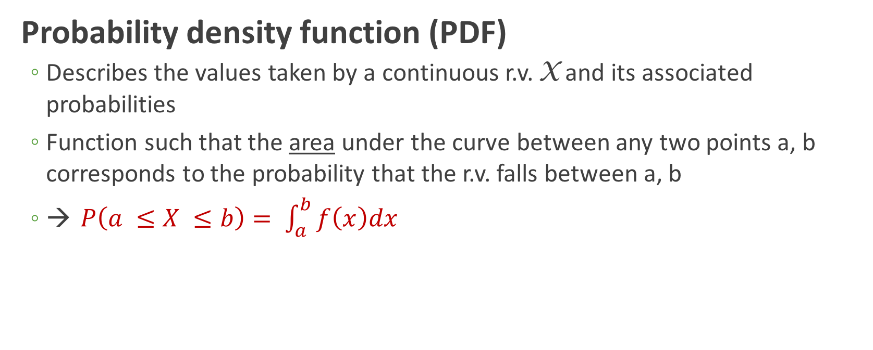
Expressing continuous random variables
Probability density function (PDF)
Describes the values taken by a continuous r.v. X and its associated probabilities
Function such that the area under the curve between any two points a, b corresponds to the probability that the r.v. falls between a, b
→ $P\left(a ≤X ≤b\right)= \int_{a}^{b}{f\left(x\right)dx}$

Slide 34
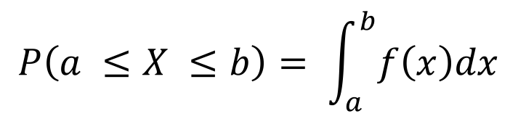
PDF
$$P\left(a ≤X ≤b\right)= \int_{a}^{b}{f\left(x\right)dx}$$

Slide 35
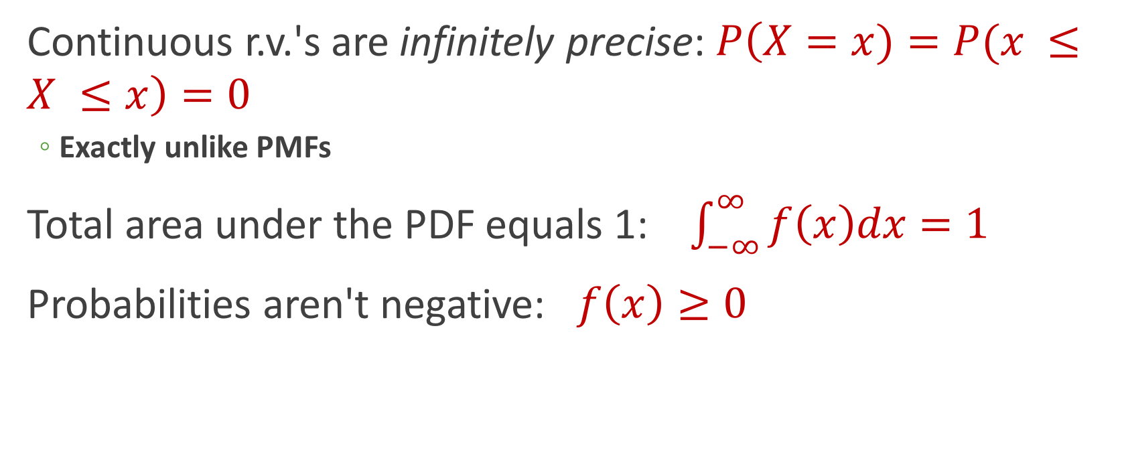
PDF properties
Continuous r.v.'s are infinitely precise: $P\left(X=x)=P(x ≤X ≤x\right)=0$
Exactly unlike PMFs
Total area under the PDF equals 1: $\int_{−∞}^{∞}{f\left(x\right)dx=1}$
Probabilities aren't negative: $f\left(x\right)≥0$

Slide 36
Expressing continuous random variables
Cumulative distribution function (CDF)
Function defined, for a specific value x of a continuous r.v. X, as F(x) = P(X ≤ x)
Look familiar?

Slide 37
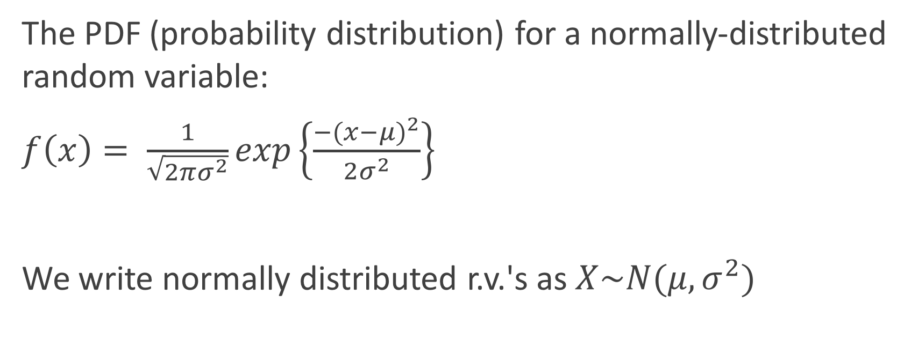
Jumping right in: Normal distribution
The PDF (probability distribution) for a normally-distributed random variable:
$f\left(x\right)= \frac{1}{\sqrt{2πσ^{2}}}exp\left\{\frac{{−(x−μ)}^{2}}{2σ^{2}}\right\}$
We write normally distributed r.v.'s as $X\sim N(μ, σ^{2})$
It's gross, everyone knows it, and you will be neither plugging nor chugging with this equation

Slide 38
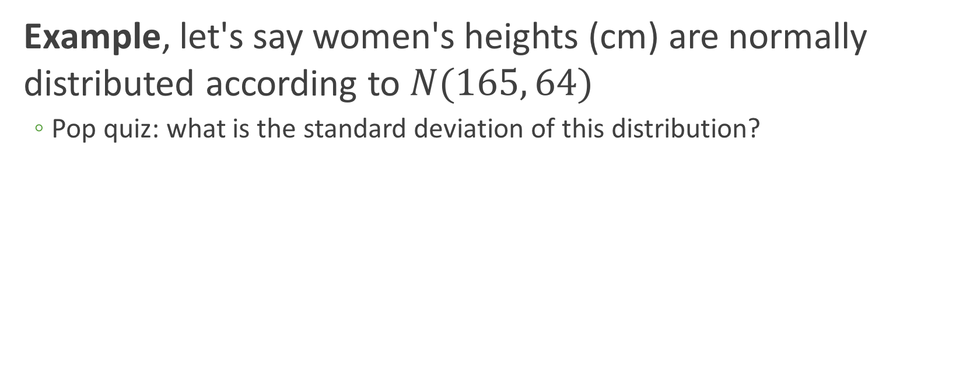
PDF of normal distribution
Example, let's say women's heights (cm) are normally distributed according to $N(165, 64)$
Pop quiz: what is the standard deviation of this distribution?

Slide 39
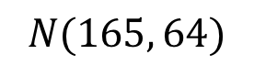
Making the PDF
Another "interesting" hack:
> plot.range <- tibble(x = c(165 - 32, 165 + 32))
> ggplot(plot.range, aes(x=x)) +
stat_function(fun = dnorm, args=list(mean=164, sd=8))
$$N(165, 64)$$

Slide 40
Making the CDF
> plot.range <- tibble(x = c(165 - 32, 165 + 32))
> ggplot(plot.range, aes(x=x)) + stat_function(fun = pnorm, args=list(mean=164, sd=8))

Slide 41
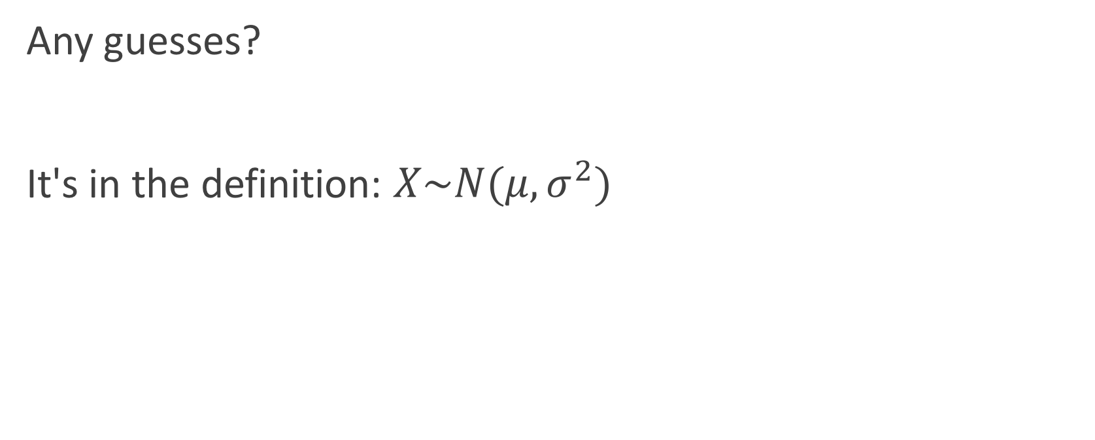
Expectation and variance
Any guesses?
It's in the definition: $X\sim N(μ, σ^{2})$

Slide 42
Working with the normal distribution
Types of questions one can ask:
What is the probability that a randomly-chosen woman is taller than 158 cm?
What is the probability that a randomly-chosen woman is between 163—170 cm tall?
What is the probability that a randomly-chosen woman is shorter than 167 cm?
What is the probability that a randomly-chosen woman is 168 cm tall?

Slide 43
Working with the normal distribution
Types of questions one can ask:
What is the probability that a randomly-chosen woman is taller than 158 cm?
What is the probability that a randomly-chosen woman is between 163—170 cm tall?
What is the probability that a randomly-chosen woman is shorter than 167 cm?
What is the probability that a randomly-chosen woman is 168 cm tall?

Slide 44
Properties of the normal distribution
Symmetric around the mean
Mean = median = mode
Inflection points

Slide 45
Introducing the standard normal: N(0, 1)
𝜇 = 0
σ = 1
These are Z-scores

Slide 46
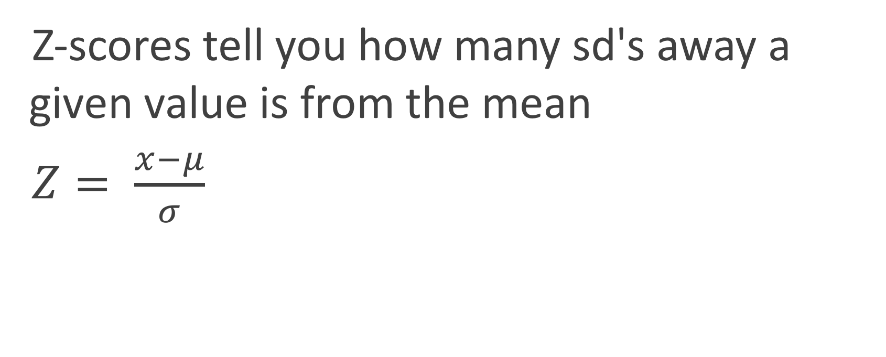
Re-scaling to standard normal to compare distributions
Z-scores tell you how many sd's away a given value is from the mean
$Z= \frac{x−μ}{σ}$
There are two related populations of snakes, whose lengths are described by the following distributions:
Population 1: N(175, 41)
Population 2: N(211, 5)
A snake from pop 1 has length 179, and from pop 2 has length 220. Who's bigger?

Slide 47
All normal distributions can be made equivalent by rescaling the x-axis
pnorm(61, 54, 4.5)
= pnorm((61-54)/4.5)
we have graduated from normal tables

Slide 48
Historical consideration of z-scores

Slide 49
Welcome to the modern age (with some tradition...)
solve a few zscore problems
show how to do this with zscores and with the goddamn computer.

Slide 51
Statistical inference
Two flavors:
Hypothesis testing (is my distribution different from an underlying population?)
Estimation (what is the mean of my underlying population?)

Slide 52
Samples vs populations
syntax

Slide 53
The sampling distribution

Slide 54
Standard error of the mean

Slide 55
The Central Limit Theorem

Slide 56
talk about the distributions themselves and what they are good for
pmf/pdf and cdf
briefly explain moments
solve some binomial probability questions
solve some normal questions and introduce Z scores
-----------------
samples vs populations
point estimation MAYBE
sample distributions vs sampling distribution
central limit theorem

Slide 57
talk about the distributions themselves and what they are good for
pmf/pdf and cdf
briefly explain moments
move to

Slide 58
PURPOSE | SYNTAX | EXAMPLE
RNORM | Generates random numbers from normal distribution | rnorm(n, mean, sd) | rnorm(1000, 3, .25) Generates 1000 numbers from a normal with mean 3 and sd=.25
DNORM | Probability Density Function (PDF) | dnorm(x, mean, sd) | dnorm(0, 0, .5) Gives the density (height of the PDF) of the normal with mean=0 and sd=.5.
PNORM | Cumulative Distribution Function (CDF) | pnorm(q, mean, sd) | pnorm(1.96, 0, 1) Gives the area under the standard normal curve to the left of 1.96, i.e. ~0.975
QNORM | Quantile Function – inverse of pnorm | qnorm(p, mean, sd) | qnorm(0.975, 0, 1) Gives the value at which the CDF of the standard normal is .975, i.e. ~1.96

